Slide 1
Crop production analysis
By Unmilan Baruah

Slide 2
Introduction
The Agriculture business domain, as a vital part of the overall supply chain, is expected to highly evolve in the upcoming years via the developments, which are taking place on the side of the Future Internet. This report uses a dataset which provides a huge amount of information on crop production in India ranging from several years. Based on the information the ultimate goal would be to predict crop production and find important insights highlighting key indicators and metrics that influence crop production. The following section makes a brief mention about this report. Finally, observations are recorded and conclusions are made.

Slide 3
Purpose
To analyze crop production based on Indian states.
To study crop production on yearly basis with the help of time series analysis.
To analyze crop production based on seasons.
To understand the distribution of crops across India.
To analyze distribution of crops based on seasons.
To study distribution of crops on yearly basis with the help of time series analysis.

Slide 4
Methodology
ETL (Extract, Transform, and Load): Collecting the data, transforming it into something which can be analyzed with accuracy, and loading the processed data for further analysis.
Data Analysis
Observations
Inference

Slide 5
ETL (Extract, Transform, and Load)
The data source is named as “Crop production data.csv” and this CSV file records related to production of crops.
There are total 246091 entries, and there are missing values in the Production column. Therefore, we have to exclude them while doing production analysis using both Python as well as Tableau.
Moreover, outliers can also be observed in the Area, and Production column. However, for the accuracy of the analysis and to avoid bias, we won’t remove the outliers. Also, we aren’t making any machine learning model for performing predictive analysis. So, removing the outliers is not an appropriate option.

Slide 6
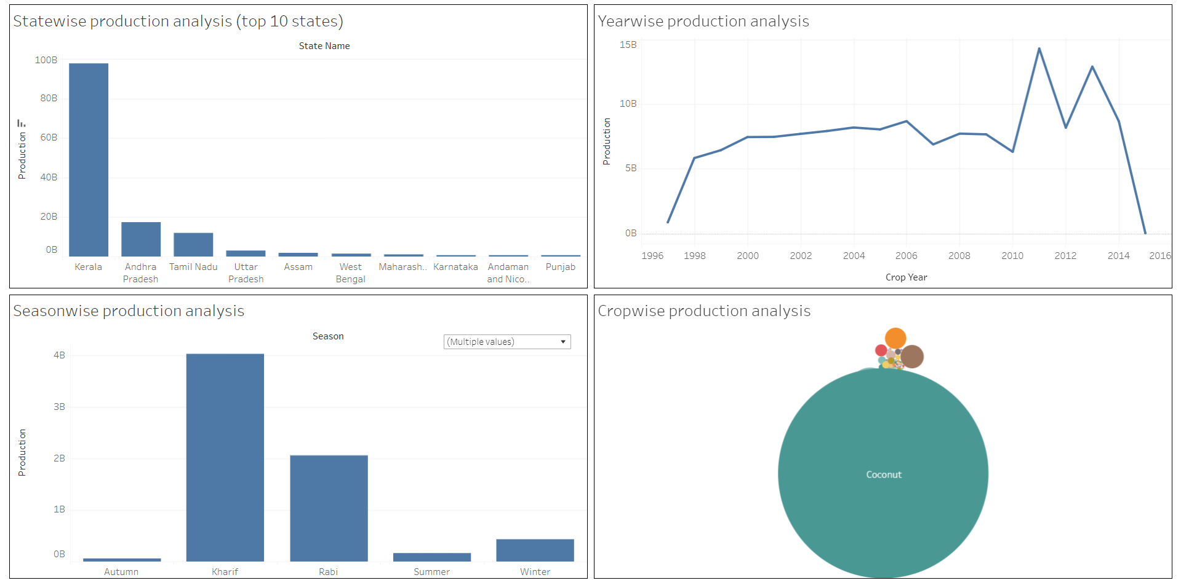
Data Analysis

Slide 7
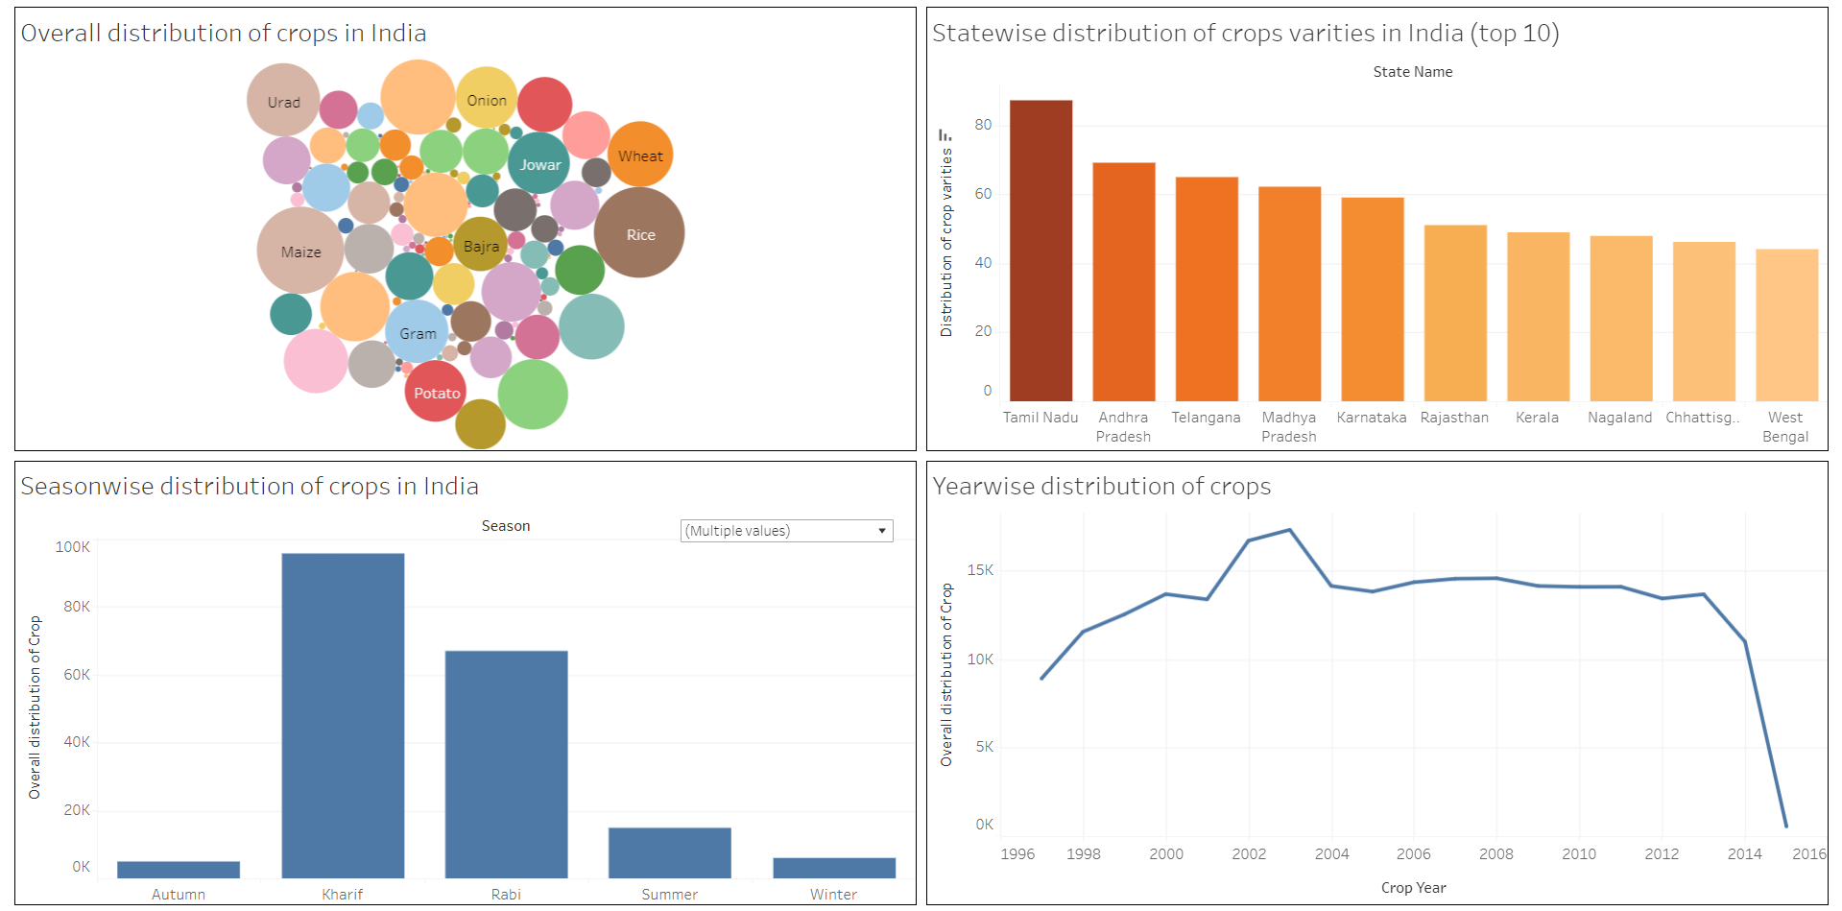
Data Analysis

Slide 8
Observations
Production is highest in Kerala state, followed by Andhra Pradesh. Top three states with highest production are in South India.
Excluding the Whole Year, the production is highest in Kharif season and followed by Rabi season.
The production is highest for the year 2011, followed by the year 2013. The production is found out to be the least in 2015.
Production of Coconut is the highest overall, followed by Rice and then by Wheat.

Slide 9
Observations
The analysis clearly indicates that crop distribution is highest for Rice, and followed by Maize.
When it comes to producing varieties of crops, then Tamil Nadu is the highest followed by Andhra Pradesh.
Based on seasons and excluding the Whole Year, the distribution of crops is observed to be the highest in Kharif season, followed by Rabi.
Distribution of crop is highest in the year 2003, followed by the year 2002.

Slide 10
Inference
Even though the overall production is highest in Kerala, the production of different crop varieties is higher in Andhra Pradesh and Tamil Nadu compared to crop production in Kerala. Moreover, it is clear that production in Kerala is the highest only because of Coconuts.
Crop with highest production is Coconut, but the most produced or the preferred crop in India is Rice and then it is Maize. High production of Coconut is mainly understandable from the fact that overall production is highest in Kerala.
Both overall production and distribution of crops is highest in Kharif, followed by Rabi season. This implies that production of crops in India is mainly visible during the Kharif season, followed by Rabi.

Slide 11
Thank You

